Slide 1
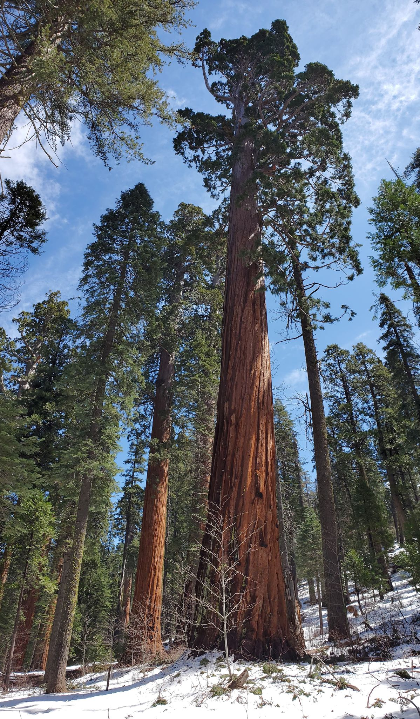
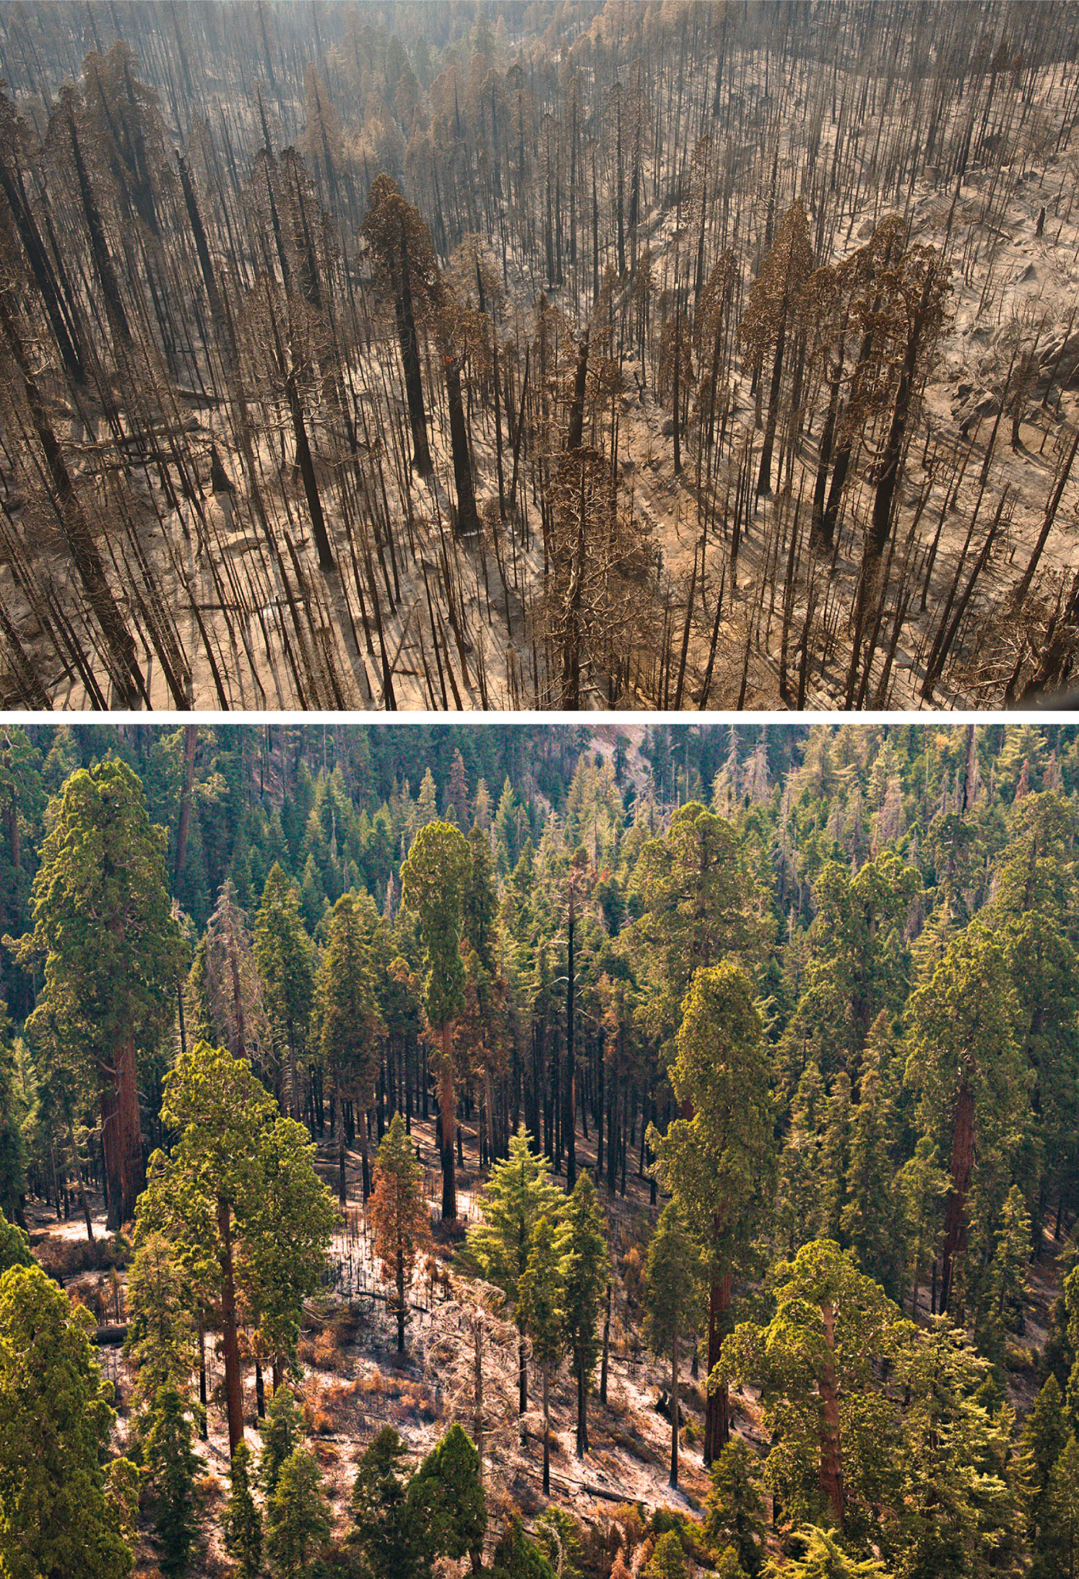
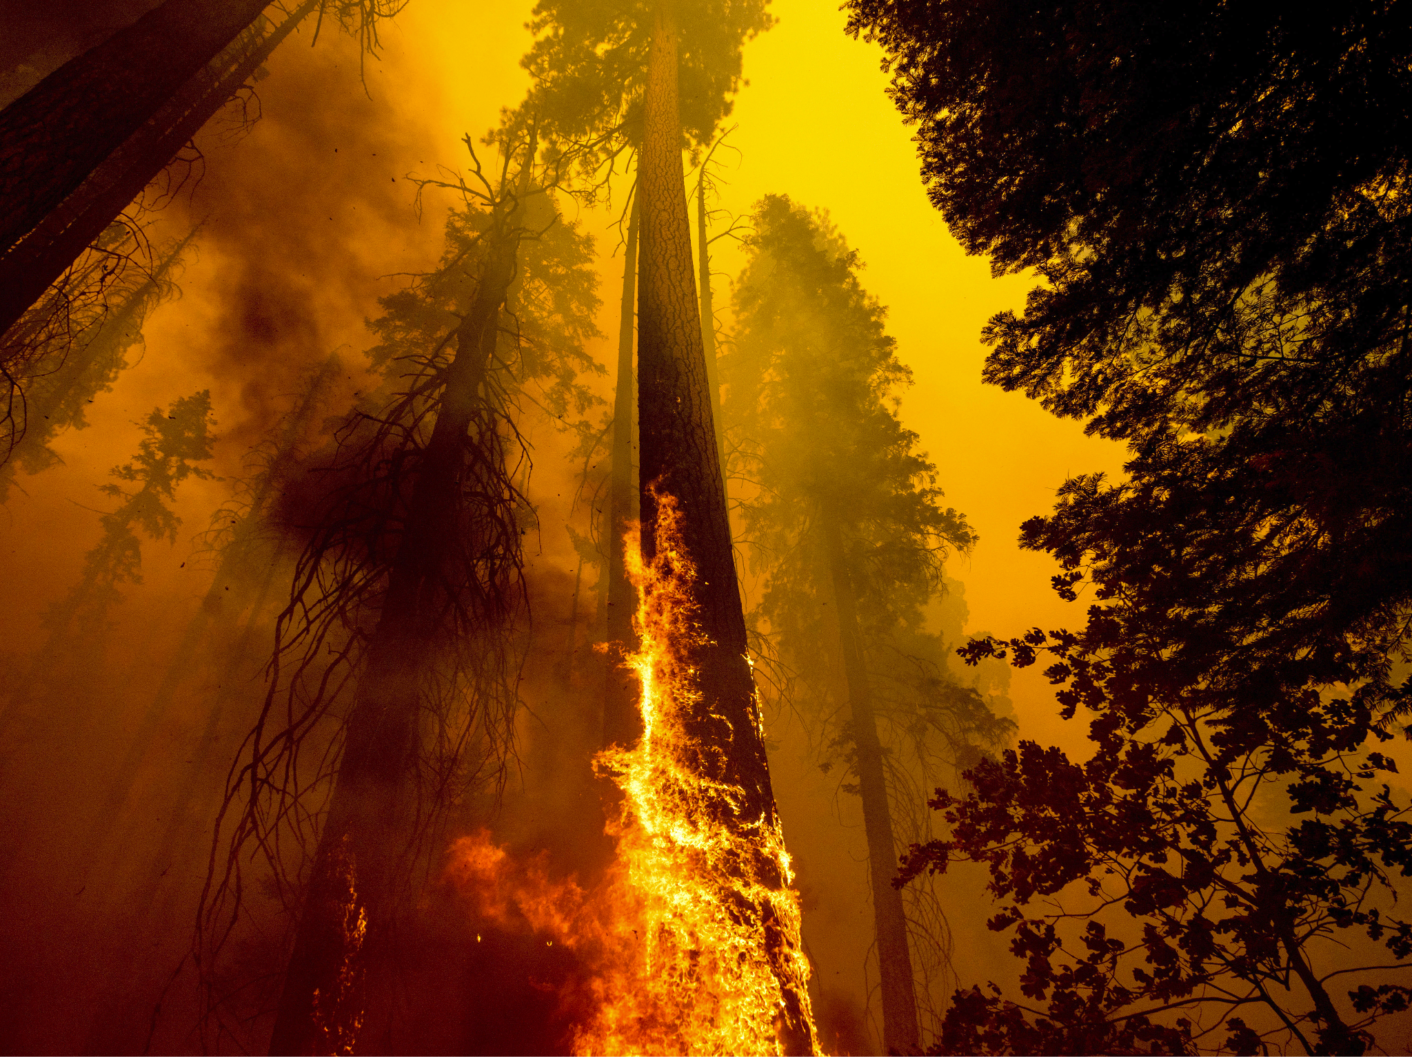

Giant Sequoia:
Endangered

Slide 2
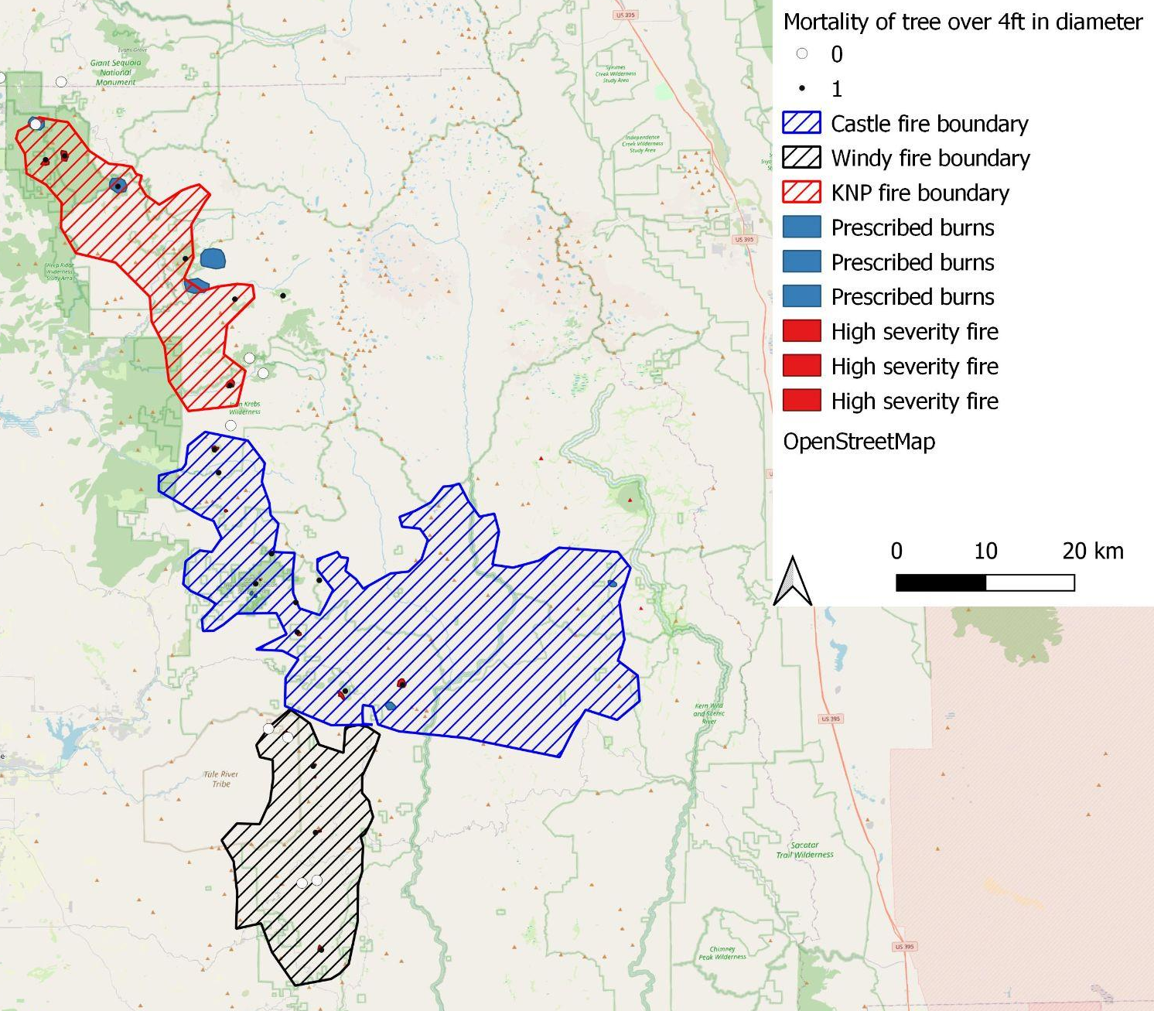
Wildfire Boundary Maps
Castle Fire (2020) Tree Mortality Based on Fire Severity
No dead trees recorded
Over 3 dead trees recorded
Fire Severity Class | Percent of all large Sequoia’s killed
High Severity | 9.02%
Moderate | 2.32%
Low | 0.94%
KNP and Windy Fires (2021) min and max tree mortality based on fire severity
Fire Severity Class | Min Mortality | Max Mortality
High | 1,653 | 1,961
Moderate | 367 | 618
Low | 0 | 669

Slide 3
